Slide 1
AZ-104T00A Administer Intersite Connectivity
Notes:
These Learn modules are part of the AZ-104: Configure and manage virtual networks for Azure administrators (https://docs.microsoft.com/learn/paths/az-104-manage-virtual-networks/) learning path.

Slide 2
Administer Intersite Connectivity Introduction
Configure VNet Peering
Configure Network Routing and Endpoints
Lab 05 - Implement Intersite Connectivity
Notes:
28 July 23 update moves Routing and Endpoints here to balance out the module.
VPN Gateway and ER/VWAN moved to the end. This content will be removed during the next update. Look to AZ-700 for content.

Slide 3


Administer Intersite Connectivity whiteboard and review
What is virtual network peering? Advantages?
What is the difference between system-defined routes and user-defined routes?
What is the difference between a service endpoint and a private endpoint?
Azure virtual networks
??
??
??
Local on-premises networks
Notes:
Optional whiteboard slide to introduce the module or review the content. Use the whiteboard diagram directly or recreate the image during the class. Focus this discussion on intersite connectivity.
What is virtual network (VNet) peering and why would use it?
Answer: VNet peering connects two Azure virtual networks. Peering can be regional or global. Peered networks use the Azure backbone which provides for privacy and isolation. VNet peering is easy to configure and offers great performance.
What is the difference between system-defined routes and user-defined routes? Give an example where each type of route would be used.
Answer: System-defined routes direct network traffic between virtual machines, on-premises networks, and the internet. System-defined routes are the default behavior for Azure routing. Examples include traffic between VMs in the same subnet, between VMs in different subnets in the same virtual network, and data flow from VMs to the internet. User-defined (custom) routes override the system routes or add routes to the routing table. Examples include routing through gateways and virtual appliances.
What is the difference between a service endpoint and a private endpoint?
Answer: A service endpoint limits network access to specific subnets and IP addresses. A service endpoint is a web address (URL) at which clients of a specific service can gain access to it. Service endpoints are supported for a variety of services including Storage, Key Vault, and SQL. A private endpoint. A private endpoint is a network interface that uses a private IP address from your virtual network. This network interface connects you privately and securely to a service through a private link. Private link integrates with on-premises and peered networks.

Slide 4
Configure VNet Peering

Slide 5
Configure VNet Peering Introduction
Determine VNet Peering Uses
Determine Gateway Transit and Connectivity Needs
Create VNet Peering
Determine Service Chaining Uses
Demonstration – VNet Peering
Summary and Resources
Notes:
Implement and manage virtual networking (15–20%)
Configure and manage virtual networks in Azure
Create and configure virtual network peering

Slide 6
Determine VNet Peering Uses
Region 1
Region 2
VNet1
Global
VNet Peering
VNet2
Regional
VNet Peering
VNet3
Two types of peering: Global and Regional
Connects two Azure virtual networks – you can peer across subscriptions and tenants
Peered networks use the Azure backbone for privacy and isolation
Easy to setup, seamless data transfer, and great performance
Notes:
Virtual network peering - https://docs.microsoft.com/azure/virtual-network/virtual-network-peering-overview

Slide 7
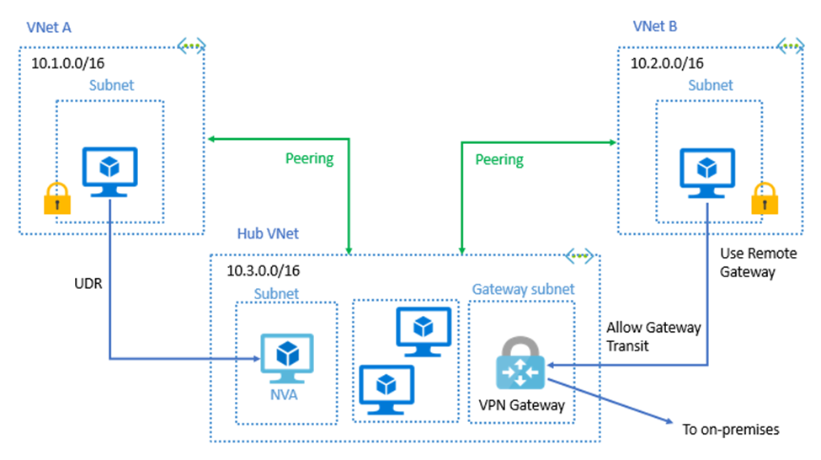

Determine Gateway Transit and Connectivity Needs
Gateway transit allows peered virtual networks to share the gateway and get access to resources
No VPN gateway is required in the peered virtual network
Default VNet peering provides full connectivity
IP address spaces of connected networks can't overlap
Notes:
Azure Virtual Network frequently asked questions (FAQ) VNet Peering - https://docs.microsoft.com/azure/virtual-network/virtual-networks-faq

Slide 8
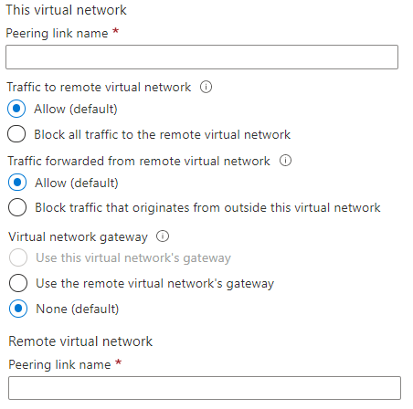
Create VNet Peering
Allow virtual network access settings
Configure forwarded traffic settings
To peering links must be created and shown in "connected" status
Notes:
Create, change, or delete a virtual network peering - https://docs.microsoft.com/azure/virtual-network/virtual-network-manage-peering#requirements-and-constraints
Tutorial: Connect virtual networks with virtual network peering using the Azure portal - https://docs.microsoft.com/azure/virtual-network/tutorial-connect-virtual-networks-portal
✔️ When you add a peering on one virtual network, the second virtual network configuration is automatically added.

Slide 9
Determine Service Chaining Uses
Leverage user-defined routes and service chaining to implement custom routing
Implement a VNet hub with a network virtual appliance or a VPN gateway
VNet2
Hub VNet
Network Virtual Appliance or
VPN Gateway
Service chaining enables you to direct traffic from one virtual network to a virtual appliance, or virtual network gateway, in a peered virtual network, through user-defined routes
VNet3
Notes:
Distribute your services across Azure virtual networks and integrate them by using virtual network peering - https://docs.microsoft.com/learn/modules/integrate-vnets-with-vnet-peering

Slide 10
Demonstration – VNet Peering
Configure VNet peering on the first virtual network
Configure a VPN gateway
Allow gateway transit
Confirm VNet peering on the second virtual network
Notes:
Connect virtual networks with VNet peering – tutorial - https://docs.microsoft.com/azure/virtual-network/tutorial-connect-virtual-networks-portal

Slide 11
Summary and Resources – Configure VNet Peering
Knowledge Check Questions
Microsoft Learn Modules (docs.microsoft.com/Learn)
Distribute your services across Azure virtual networks and integrate them by using virtual network peering (Sandbox)
A sandbox indicates a hands-on exercise.
Notes:
Learn - https://docs.microsoft.com/learn/browse/
The Assessment Guide in the MCT DLC has open-ended questions.
What is virtual network (VNet) peering and why would use it?
Answer: VNet peering connects two Azure virtual networks. Peering can be regional or global. Peered networks use the Azure backbone which provides for privacy and isolation. VNet peering is easy to configure and offers great performance.

Slide 12
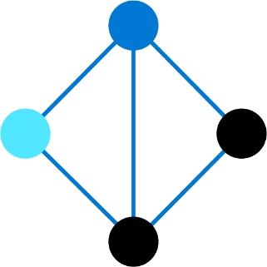
Configure Network Routing and Endpoints

Slide 13
Configure Network Routing and Endpoints Introduction
Review System Routes
Identify User-Defined Routes
Demonstration – Custom Routing tables
Determine Service Endpoint Uses
Identify Private Link Uses
Summary and Resources
Notes:
Implement and manage virtual networking (15–20%)
Configure and manage virtual networks in Azure
Configure user-defined network routes
Configure secure access to virtual networks
Configure service endpoints for Azure platform as a service (PaaS)
Configure private endpoints for Azure PaaS

Slide 14

Review System Routes
System routes direct network traffic between virtual machines, on-premises networks, and the internet:
Traffic between VMs in the same subnet
Between VMs in different subnets in the same virtual network
Data flow from VMs to the internet
Communication between VMs using a VNet-to-VNet VPN
Site-to-Site and ExpressRoute communication through the VPN gateway
Internet
System
Route
System
Route
Frontend Subnet
Backend Subnet
Routing Table
Virtual Network
Notes:
System routes - https://docs.microsoft.com/azure/virtual-network/virtual-networks-udr-overview#system-routes

Slide 15
Identify User-Defined Routes
A route table contains a set of rules, called routes, that specifies how packets should be routed in a virtual network
Internet
User defined route
VM/Appliance
IP Forwarding
User-defined routes are custom routes that control network traffic by defining routes that specify the next hop of the traffic flow
System
Route
Frontend Subnet
Backend Subnet
The next hop can be a virtual network gateway, virtual network, internet, or virtual appliance
User defined route
VM/Appliance
IP Forwarding
Virtual Network
Notes:
Virtual network traffic routing - https://docs.microsoft.com/azure/virtual-network/virtual-networks-udr-overview
✔ Each route table can be associated to multiple subnets, but a subnet can only be associated to a single route table. There are no additional charges for creating route tables in Microsoft Azure. Do you think you will need to create custom routes?

Slide 16
Demonstration – Custom Routing Tables
Create a route table
Add a route
Associate a route table to a subnet
Use PowerShell to view your routing information (optional)
Notes:
Route network traffic - tutorial - Azure portal - https://learn.microsoft.com/azure/virtual-network/tutorial-create-route-table-portal#create-a-route-table

Slide 17
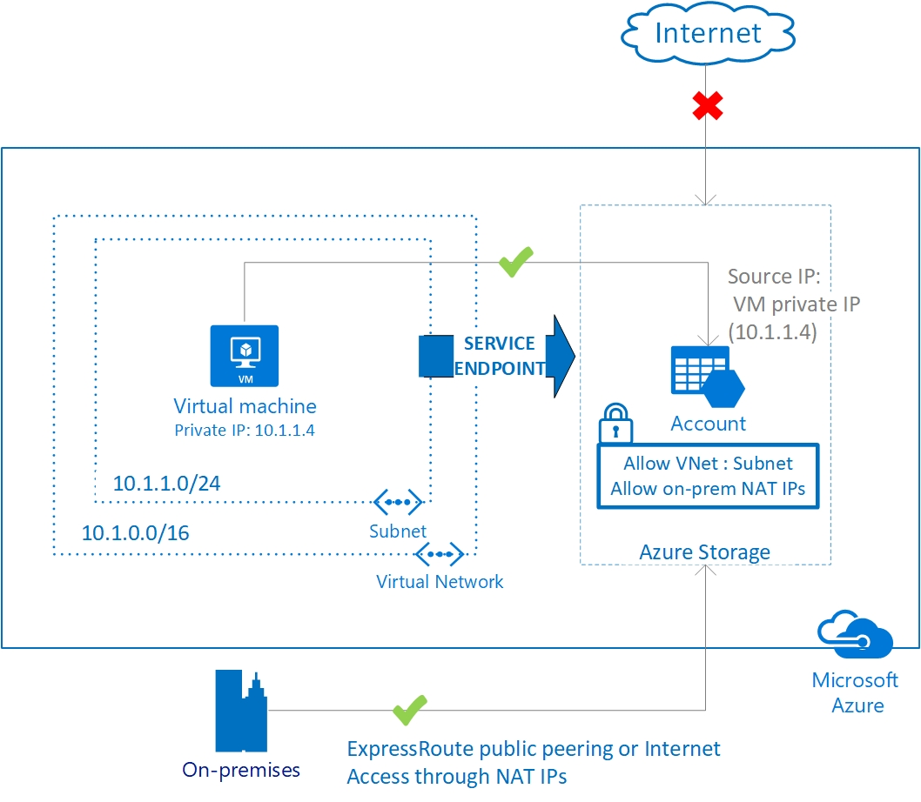
Determine Service Endpoint Uses
Endpoints limit network access to specific services -Adding service endpoints can take up to 15 minutes to complete
Notes:
This is 2 topics in the student content.
Virtual network service endpoints - https://docs.microsoft.com/azure/virtual-network/virtual-network-service-endpoints-overview
Tutorial: Restrict network access to PaaS resources with virtual network service endpoints using the Azure portal - https://docs.microsoft.com/azure/virtual-network/tutorial-restrict-network-access-to-resources
Improved security for your resources
Optimal routing for your services
Uses the Azure backbone and is simple to configure
✔️ Can you see a use for service endpoints in your organization?

Slide 18
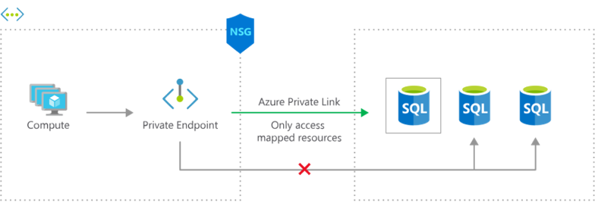
Identify Private Link Uses
Private connectivity to services on Azure. Traffic remains on the Microsoft network, with no public internet access
Integration with on-premises and peered networks
In the event of a security incident within your network, only the mapped resource would be accessible
Notes:
Private Link Documentation - https://docs.microsoft.com/azure/private-link/

Slide 19
Summary and Resources – Configure Network Routing and Endpoints
Knowledge Check Questions
Microsoft Learn Modules (docs.microsoft.com/Learn)
Manage and control traffic flow in your Azure deployment with routes (Sandbox)
Introduction to Azure Private Link
A sandbox indicates a hands-on exercise.
Notes:
Learn - https://docs.microsoft.com/learn/browse
The Assessment Guide in the MCT DLC has open-ended questions.
What is the difference between system-defined routes and user-defined routes? Give an example where each type of route would be used.
Answer: System-defined routes direct network traffic between virtual machines, on-premises networks, and the internet. System-defined routes are the default behavior for Azure routing. Examples include traffic between VMs in the same subnet, between VMs in different subnets in the same virtual network, and data flow from VMs to the internet. User-defined (custom) routes override the system routes or add routes to the routing table. Examples include routing through gateways and virtual appliances.
What is the difference between a service endpoint and a private endpoint?
Answer: A service endpoint limits network access to specific subnets and IP addresses. A service endpoint is a web address (URL) at which clients of a specific service can gain access to it. Service endpoints are supported for a variety of services including Storage, Key Vault, and SQL. A private endpoint. A private endpoint is a network interface that uses a private IP address from your virtual network. This network interface connects you privately and securely to a service through a private link. Private link integrates with on-premises and peered networks.

Slide 20
Lab 05 - Implement Intersite Connectivity

Slide 21













Module Review Activity
??
On-premises machine
??
Name?
Name?
??
Name?
Name?
??
On-premises network
Application
gateway
Azure
firewall
Load
balancer
NAT
Private
endpoint
Service
endpoint
VNet Peering
VPN
Gateway
Notes:
Use the diagram to engage students and reinforce topics that have just been covered. If you remove the green square (??) the product icon will show. Discuss the options with the students.
Site to site = On-premises networks to Azure virtual networks
Point to Site = On-premises machines to Azure virtual networks
Gateway subnet name = GatewaySubnet
Azure firewall subnet name = AzureFirewallSubnet

Slide 22
Lab 05 – Implement intersite connectivity
Lab scenario
Contoso has its datacenters in Boston, New York, and Seattle offices connected via a mesh wide-area network links, with full connectivity between them. You need to implement a lab environment that will reflect the topology of the Contoso's on-premises networks and verify its functionality
Objectives
Task 1:
Provision the lab environment
Task 2:
Configure local and global virtual network peering
Task 3:
Test intersite connectivity
Next slide for an architecture diagram
Notes:
LAB 05 - Implement Intersite Connectivity - ESTIMATED DURATION 30 MIN
GitHub Repository - https://microsoftlearning.github.io/AZ-104-MicrosoftAzureAdministrator/
This issue discusses how to use Lab 05 and Lab 06 - https://github.com/MicrosoftLearning/AZ-104-MicrosoftAzureAdministrator/issues/726

Slide 23

Lab 05 – Architecture diagram
Region1
Task 1
az104-05-rg1
az104-05-vnet0 10.50.0.0/22
Region2
Subnet0 10.50.0.0/24
Task 2, Task 3
az104-05-rg1
az104-05-vm0
10.50.0.4
Global Peering
az104-05-vnet2 10.52.0.0/22
Subnet0 10.52.0.0/24
az104-05-rg1
Local Peering
Global Peering
az104-05-vm2
10.52.0.4
Subnet0 10.51.0.0/24
az104-05-vm1
10.51.0.4
az104-05-vnet1 10.51.0.0/22

Slide 24

End of presentation

Slide 25
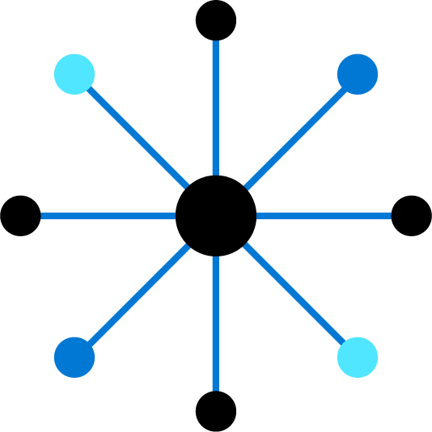
Configure VPN Gateway (Optional)
Notes:
These slides will be removed in the course release. AZ-700 provides coverage.

Slide 26
Configure VPN Gateway Introduction (Optional)
Determine VPN Gateway Uses
Create Site-to-Site Connections
Demonstration- VPN Gateway
Create the Gateway Subnet
Create the VPN Gateway
Determine Gateway SKU and Generation
Create the Local Network Gateway
Configure the On-premises VPN Device
Create the VPN Connection
Determine High Availability Scenarios
Summary and Resources
Notes:
VPN Gateway in not on the AZ-104 certification. This section is optional and provided only if your audience is interested.

Slide 27



Determine VPN Gateway Uses
Azure
Point-to-Site
VNet 1
VNet 2
VNet-to-VNet
Local on-premises network
Site-to-Site
VNet-to-VNet connections connect Azure virtual networks – VNet peering or custom
Point-to-Site (User VPN) connections connect individual devices to Azure virtual networks
Site-to-Site connections connect on-premises datacenters to Azure virtual networks
Notes:
What is VPN Gateway? - https://docs.microsoft.com/azure/vpn-gateway/vpn-gateway-about-vpngateways

Slide 28
Create Site-to-Site VPN Connections
Azure
On-premises
Azure
Public IP address
Create the Gateway Subnet
Create the VPN Gateway
Create the Local Network Gateway
Configure the VPN Device
Create the VPN Connection
IP or FQDN
Take time to carefully plan your network configuration
The on-premises part is necessary only if you are configuring Site-to-Site
Always verify and test your connections
Notes:
The steps on this slide that are greyed out are not covered in the slides. Check the Extras Slides section at the end of the presentation for an older version slide. The blue steps have additional slides.
You could walk-thru the Tutorial: Create a site-to-site VPN connection in the Azure portal -https://docs.microsoft.com/azure/vpn-gateway/tutorial-site-to-site-portal
Connect your on-premises network to Azure with VPN Gateway - https://docs.microsoft.com/learn/modules/connect-on-premises-network-with-vpn-gateway/
Create the Gateway Subnet - When you create your gateway subnet, gateway VMs are deployed to the gateway subnet and configured with the required VPN gateway settings. Never deploy other resources (for example, additional VMs) to the gateway subnet.
Create the Local Network Gateway - Reflects the on-premises network configuration. Specify the IP address prefixes that will be routed through the gateway to the VPN device.

Slide 29
Demonstration – VPN gateways
Explore the Gateway subnet blade
Explore the Connected Devices blade
Explore adding a virtual network gateway
Explore adding a connection between the virtual networks
Notes:
✔ Always consider having students walk-through the demonstrations themselves. Also, consider the overlap with the formal labs and your best use of time.
Either do the demonstration or walk-through the slides.

Slide 30
Create the Gateway Subnet
When you create your gateway subnet, gateway VMs are deployed to the gateway subnet and configured with the required VPN gateway settings
The gateway subnet contains the IP addresses; if possible, use a CIDR block of /28 or /27
Never deploy other resources (for example, additional VMs) to the gateway subnet

Slide 31
Create the VPN Gateway
Most VPN Gateways are Route-based
Your choice of gateway SKU affects the number of connections you can have and the aggregate throughput benchmark
Associate the virtual network that includes the Gateway Subnet – need a public IP address
It can take up to 45 minutes to provision the VPN gateway
Notes:
The next slide is hidden but has the SKU and Generation example table.
Route-based VPNs use routes in the IP forwarding or routing table to direct packets. Route-based has support for IKEv2 and can use dynamic routing protocols.
Policy-based VPNs encrypt and direct packets through IPsec tunnels based on the IPsec policies. Policy-based only supports IKEv1 which some legacy on-premises VPN devices still use.
Wikipedia – BGP - Border Gateway Protocol is a standardized exterior gateway protocol designed to exchange routing and reachability information among autonomous systems on the Internet.

Slide 32
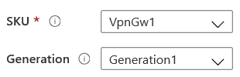
Determine Gateway SKU and Generation
Sampling of available SKUs
Gen | SKU | S2S/VNet-to-VNet Tunnels | P2S IKEv2 Connections | Throughput Benchmark
1 | VpnGw1/Az | Max. 30 | Max. 250 | 650 Mbps
1 | VpnGw2/Az | Max. 30 | Max. 500 | 1.0 Gbps
2 | VpnGw2/Az | Max. 30 | Max. 500 | 1.25 Gbps
1 | VpnGw3/Az | Max. 30 | Max. 1000 | 1.25 Gbps
2 | VpnGw3/Az | Max. 30 | Max. 1000 | 2.5 Gbps
2 | VpnGw4/Az | Max. 100 | Max. 5000 | 5.0 Gbps
2 | VpnGw5/Az | Max. 100 | Max. 10000 | 10.0 Gbps
The Gateway SKU affects the connections and the throughput
Resizing is allowed within the generation
The Basic SKU (not shown) is legacy and should not be used
Notes:
About VPN Gateway configuration settings - https://docs.microsoft.com/azure/vpn-gateway/vpn-gateway-about-vpn-gateway-settings
Create a route-based VPN gateway using the Azure portal - https://docs.microsoft.com/azure/vpn-gateway/create-routebased-vpn-gateway-portal
This table is just a sample of the SKUs that are available. There are many more.

Slide 33
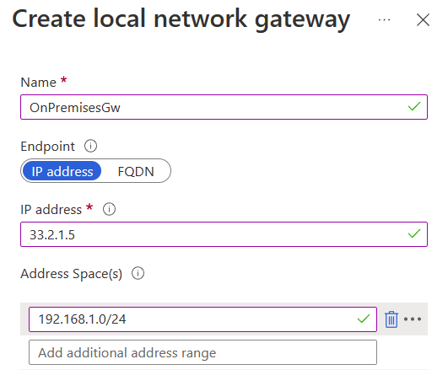
Create the Local Network Gateway
Reflects the on-premises network configuration
Give the site a name by which Azure can refer to it
Use a public IP address or FQDN for Local Network Gateway Endpoint
Specify the IP address prefixes that will be routed through the gateway to the VPN device

Slide 34
Configure the On-premises VPN Device
Consult the list of supported VPN devices
Sampling of supported VPN devices
Vendor | Device Family
Barracuda Networks, Inc. | Barracuda CloudGen Firewall
Cisco | ASA, ASR, ISR
Citrix | NetScaler MPX, SDX, VPX
Juniper | SRX, J-Series, ISG, SSG
F5 | BIG-IP Series
Palo Alto Networks | All devices running PAN-OS
A VPN device configuration script may be available
Remember the shared key for the Azure connection
Specify the public IP address of the VPN Gateway
Notes:
About VPN devices and IPsec/IKE parameters for Site-to-Site VPN Gateway connections - https://docs.microsoft.com/azure/vpn-gateway/vpn-gateway-about-vpn-devices

Slide 35
Create the VPN Connection
Once your VPN gateways is created and the on-premises device is configured, create a connection object
Configure a name for the connection and specify the type as Site-to-site (IPsec)
Select the VPN gateway and the Local Network Gateway
Enter the Shared key for the connection

Slide 36
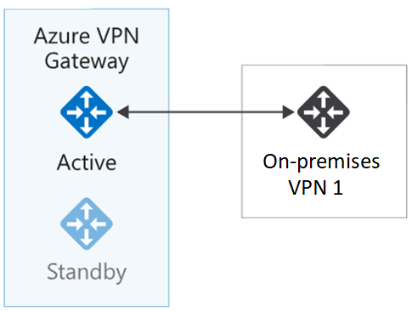
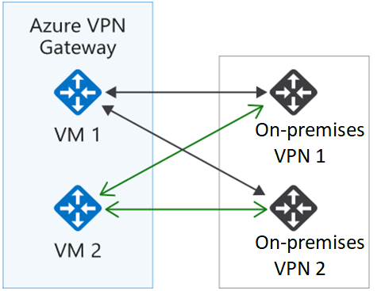
Determine High Availability Scenarios
Active/standby (default)
Active/active
VPN gateways are deployed as two instances
Enable active/active mode for higher availability
Notes:
Highly Available Cross-Premises and VNet-to-VNet Connectivity - https://docs.microsoft.com/azure/vpn-gateway/vpn-gateway-highlyavailable

Slide 37
Summary and Resources – Configure VPN Gateway
Knowledge Check Questions
Microsoft Learn Modules (docs.microsoft.com/Learn)
Introduction to Azure VPN Gateway
Connect your on-premises network to Azure with VPN Gateway (Sandbox)
A sandbox indicates a hands-on exercise.
Notes:
Learn - https://docs.microsoft.com/learn/browse/
The Assessment Guide in the MCT DLC has open-ended questions.
Describe at least three uses of a VPN gateway.
Answer: A VPN gateway can be used for site-to-site connections that connect on-premises datacenters to Azure virtual networks. A VPN gateway can be used for custom VNet-to-VNet connections between virtual networks. A VPN gateway can be used for point-to-site (User VPN) connections between individual devices and the Azure network. A VPN gateway is configured for VNet peering.
Explain two ways VPN gateways could be used in a high availability scenario.
Answer: In a high availability scenario two VPN gateways are deployed. The configuration can be either Active/Standby or Active/Active. In Active/Standby mode the second VPN gateway does not establish a connection until there is a failure. In Active/Active mode both gateway instances establish a connection.

Slide 38
Configure ExpressRoute and Virtual WAN (Remove)
Notes:
These slides will be removed in the course release. AZ-700 provides coverage.

Slide 39
Configure ExpressRoute and Virtual WAN Introduction (Optional)
Determine ExpressRoute Uses
Determine ExpressRoute Capabilities
Coexist Site-to-Site and ExpressRoute
Compare Intersite Connection Options
Determine Virtual WAN Uses
Summary and Resources
Notes:
ExpressRoute and Virtual WAN are not on the AZ-104 certification. The content is included only if your audience is interested.

Slide 40
Determine ExpressRoute Uses
Primary Connection
Secondary Connection
ExpressRoute Circuit
Office 365, CRM
VNets, Apps
Partner
Edge
Microsoft
Edge
On-premises
Customer Network
Private connections between your on-premises network and Microsoft datacenters
Connections do not go over the public Internet – Partner network
Secure, reliable, low latency, high speed connections
Notes:
ExpressRoute - https://azure.microsoft.com/services/expressroute/

Slide 41
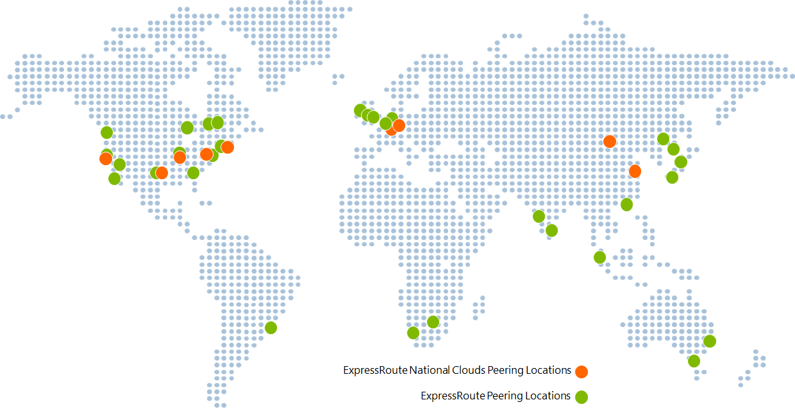
Determine ExpressRoute Capabilities
Layer 3 connectivity with redundancy
Connectivity to all regions within a geography
Global connectivity with ExpressRoute premium add-on
Across on-premises connectivity with ExpressRoute Global Reach
Bandwidth options – 50 Mbps to 100 Gbps
Billing models – Unlimited, metered, premium
Notes:
ExpressRoute overview - https://docs.microsoft.com/azure/expressroute/expressroute-introduction

Slide 42
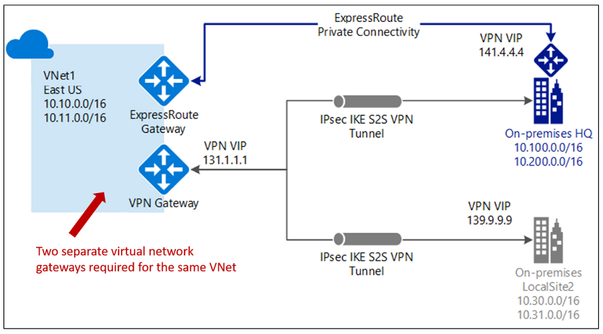
Coexist Site-to-Site and ExpressRoute
Use S2S VPN as a secure failover path for ExpressRoute
Use S2S VPNs to connect to sites that are not connected with ExpressRoute
Notice two VNet gateways for the same virtual network
Notes:
Tutorial: Create and modify an ExpressRoute circuit - https://docs.microsoft.com/azure/expressroute/expressroute-howto-circuit-portal-resource-manager
Connect your on-premises network to the Microsoft global network by using ExpressRoute - https://docs.microsoft.com/learn/modules/connect-on-premises-network-with-expressroute/
Two gateways (VPN & Expressroute) can be enabled on the same gateway subnet by using PowerShell.

Slide 43
Compare Intersite Connection Options
Connection | Azure services supported | Bandwidth | Protocols | Typical use case
Virtual network, point-to-site | Azure IaaS services, Azure Virtual Machines | Based on the gateway SKU | Active/passive | Dev, test, and lab environments for cloud services and virtual machines
Virtual network, site-to-site | Azure IaaS services, Azure Virtual Machines | Typically, <1 Gbps aggregate | Active/passive Active/active | Dev, test, and lab environments. Small-scale production workloads and virtual machines
ExpressRoute | Azure IaaS and PaaS services, Microsoft 365 services | 50 Mbps up to 100 Gbps | Active/active | Enterprise-class and mission-critical workloads. Big data solutions

Slide 44
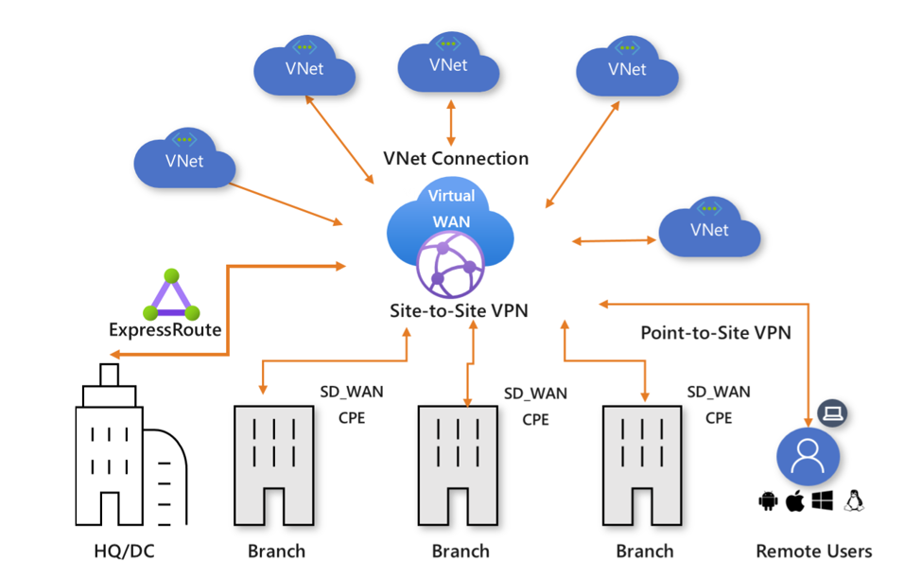
Determine Virtual WAN Uses
Brings together S2S, P2S, and ExpressRoute
Integrated connectivity using a hub-and-spoke connectivity model
Connect virtual networks and workloads to the Azure hub automatically
Visualize the end-to-end flow within Azure
Two types: Basic and Standard
Notes:
About Azure Virtual WAN - https://docs.microsoft.com/azure/virtual-wan/virtual-wan-about
Tutorial: Create a Site-to-Site connection using Azure Virtual WAN - https://docs.microsoft.com/azure/virtual-wan/virtual-wan-site-to-site-portal

Slide 45
Summary and Resources – Configure ExpressRoute and Virtual WANs
Knowledge Check Questions
Microsoft Learn Modules (docs.microsoft.com/Learn)
Introduction to Azure ExpressRoute
Design and implement Azure ExpressRoute
Introduction to Azure Virtual WAN
Notes:
Learn - https://docs.microsoft.com/learn/browse/
The Assessment Guide in the MCT DLC has open-ended questions.
Describe Azure ExpressRoute and at least three features.
Answer: Azure ExpressRoute creates private connections between Azure datacenters and infrastructure on your premises or in a colocation environment. ExpressRoute connections don't go over the public internet, instead connections use a partner network. ExpressRoute offers reliability, faster speeds, and lower latencies than typical internet connections. Bandwidth options are from 50 Mbps to 100 Gbps. Several billing options are available including unlimited, metered, and premium.
Describe Azure Virtual WAN (VWAN) and at least three features.
Answer: Azure VWAN is a networking service that brings many networking, security, and routing functionalities together. Azure VWAN can combine site-to-site, point-to-point, and ExpressRoute connections. VWAN provides integrated connectivity with a hub-spoke topology. VWAN makes it easy to connect workloads and visualize the end-to-end flow. VWAN has two pricing options, basic and standard.

